Slide 1
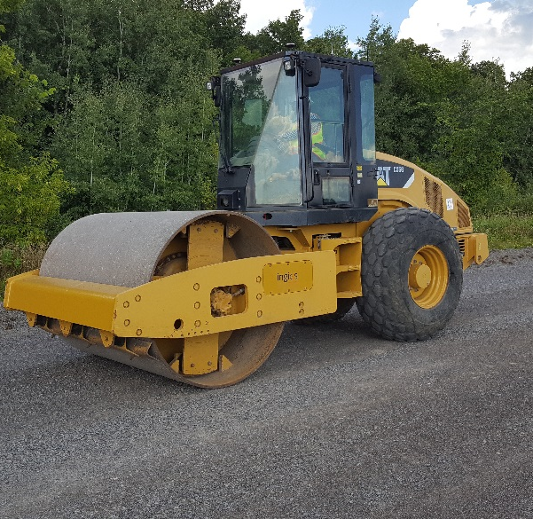
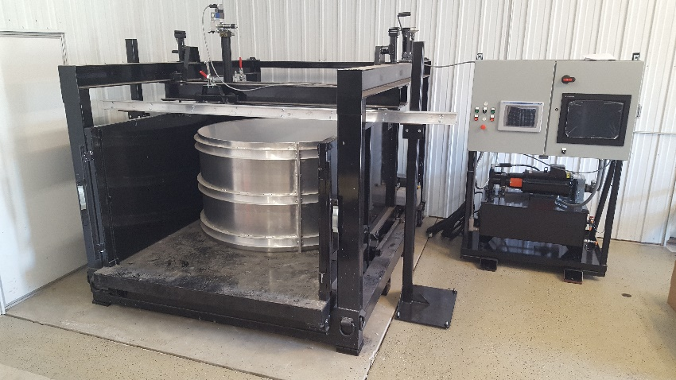
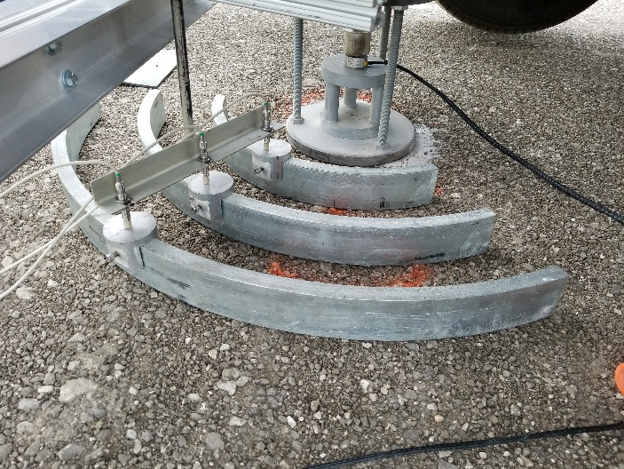
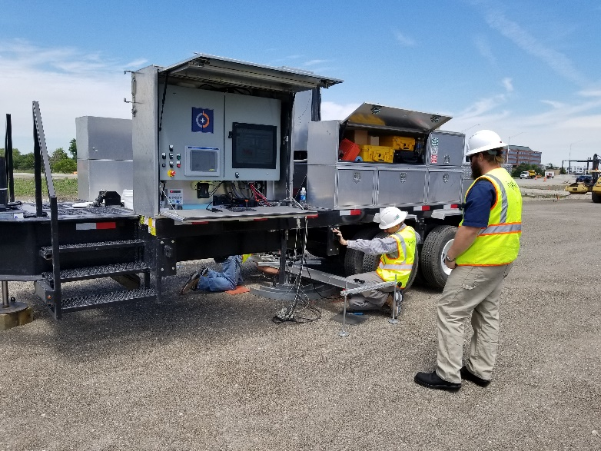

Ingios Geotechnics, Inc.
Presenter:
David J. White, Ph.D., P.E.
President and Chief Engineer
david.white@Ingios.com
515-509-7587
Contact Info:
www.ingios.com
1-877-325-6278

Slide 2
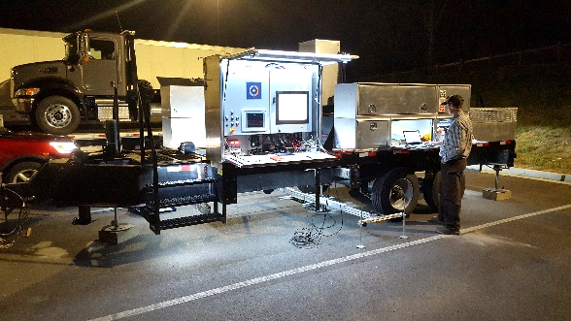
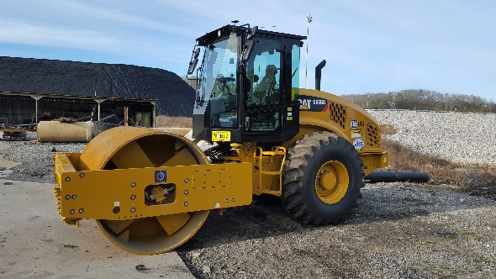
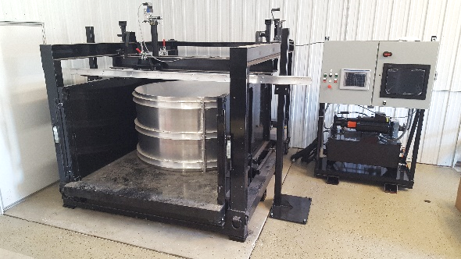
Ingios Geotechnics, Inc: Solutions
APLT*
Pavement System Mechanistic Verification and Optimization
Verify in situ stress-dependent resilient modulus for AASHTOWare™ Pavement ME
Predict permanent deformation performance over life of pavement loading
Assess multi-layer modulus
Test crack resistance of HMA
VIC*
Validated Intelligent Compaction (VIC) Control
Real-time monitoring results
Automated reporting
Advanced software tools
Efficient data management, sharing, and alert notifications
IMAS*
Accelerated Pavement
Testing
1,000,000 loading cycles
Pre-design verification of alternative systems
Verify in situ stress-dependent resilient modulus for AASHTOWare™ Pavement ME

Slide 3

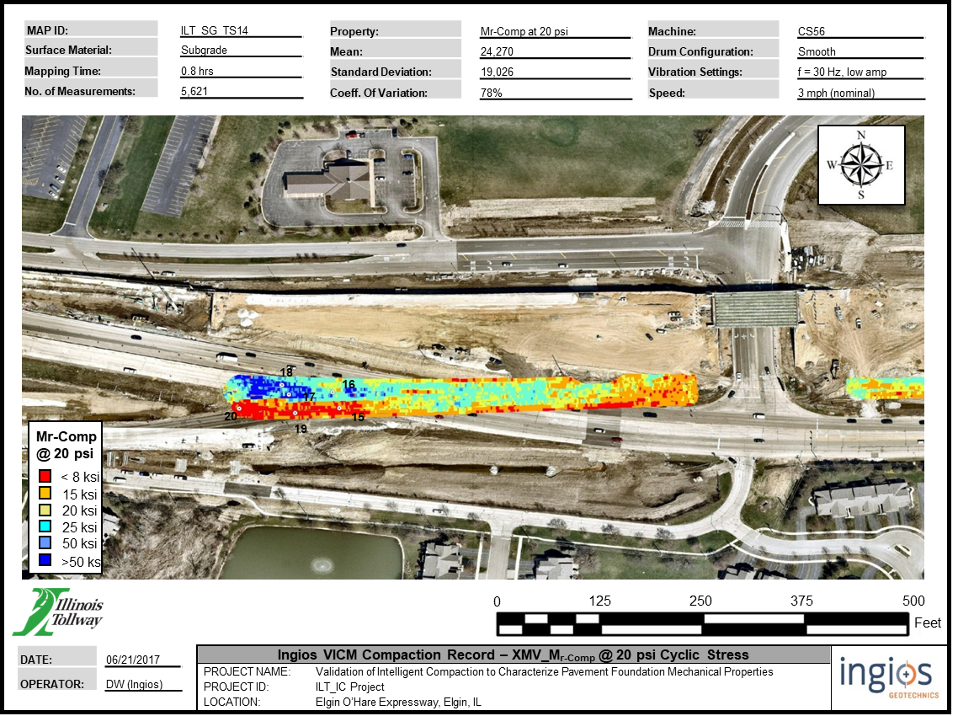
Validated Intelligent Compaction (VIC)
Outputs:
Real-Time Monitoring
Engineering Reports
Email Alert Messages
Control charts
Calibration Verification
WebCam and Pictures
QC/QA Records
Asset Mapping
QC/QA Test Locations
Compaction Cost Analyzer
Customizable solutions for each machine, each site, and each customer.
Options for GNSS:
SBAS (WAAS), OmniSTAR, D-GPS, RTK-GPS, dual antenna, IMUs
Computer screen showing spatial color-coded data overlain on georeferenced aerial image
Position Sensors
Sensor
Sensor
Vibrating Drum
Layer 1
Layer 2
Vibrations transmitted into ground
Layer 3
Options for Engineering Outputs:
M_{r}, E_{s}, k-value, CBR, g_{d}*, w%*, Material type

Slide 4

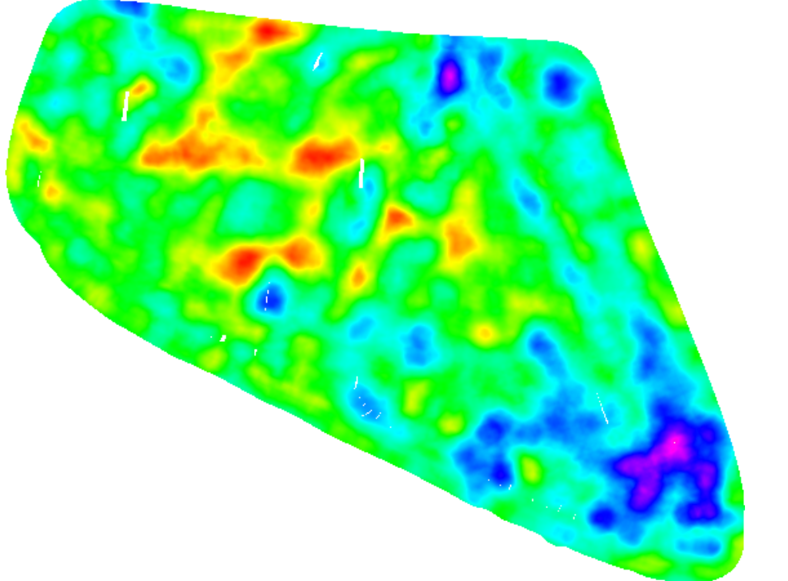

Ingios Technology
Validated Intelligent Compaction (VIC)
How it works…
Integrate sensor package into machine (options for stress-dependent modulus, 40+ different material outputs, and material/moisture vision system)
VIC is field calibrated using APLT for site conditions
Display real-time results to operator and via real-time CID dashboard system
Auto-generate compaction reports and alert messages to team, including function for P.E. review
Use advanced desktop software to analysis multi-layer properties and identify areas for QA/QC testing
Identify areas for improvement (not compaction)
Improve compaction efficiency and reduce risk of poor-quality

Slide 5
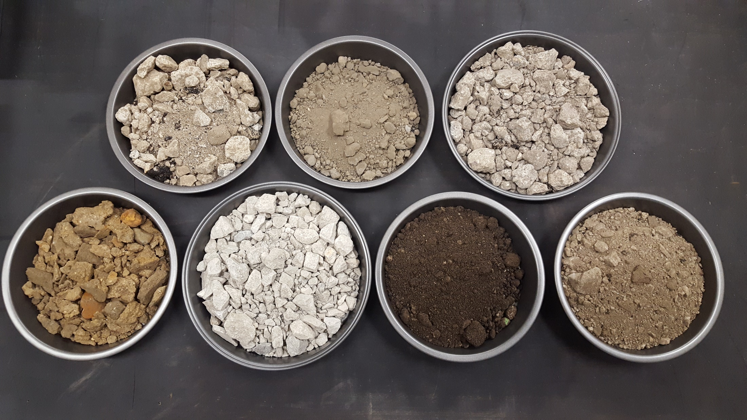
Geo-materials are complex and highly variable

Slide 6
Material Name | Material Type ID | Color
Other | 0
Fly Ash | 1
Bottom Ash | 2
Gypsum | 3
Subgrade_1 | 4
Subgrade_2 | 5
Subgrade_3 | 6
Aggregate Base_1 | 7
Aggregate Base_2 | 8
Aggregate Base_3 | 9
Glacial Till | 10
Grey Clay | 11
Red Clay | 12
Brown Clay | 13
Dark Clay | 14
Light Clay | 15
Silt | 16
Sand | 17
Silty Clay | 18
Silty Sand | 19
Gravel | 20
Subbase | 21
RAP | 22
RPCC | 23
Cement Stabilized Subgrade | 24
Cement Stabilized Base | 25
Lime Treated Subgrade | 26
Stabilized Subgrade | 27
Treated Subgrade | 28
Stabilized Aggregate Base | 29
Limestone | 30
Modified Subbase | 31
Select backfill | 32
PGE | 33
CA6 | 34
Class 5 Aggregate Base | 35
OGB | 36
0.75-inch minus | 37
1-inch minus | 38
1.5-inch minus | 39
Ingios Technology
Validated Intelligent Compaction (VIC)
We have initiated a database of common material types to assist contractors with initial pre-calibration process.

Slide 7
Ingios is redefining quality compaction
CQI = Compaction Quality Index. CQI is a measure of the compaction quality in terms of the percentage of VIC measurement values (MVs) (e.g., XMV) greater than the target value (TV) and the variability of the MVs in terms of coefficient of variation (COV). CQI is higher for higher MVs and lower variability.
VIC QUALITY ANALYSIS
112.5
CQI ≥ [95]
_% of MVs = Percentage of VIC measurement values (MVs) (e.g., XMV) greater than the target value (TV) for a map area.
98.5
[80%] of [XMV] MVs ≥ [XMV_TV]
COV of MVs = Coefficient of Variation of the Measurement Values. COV is calculated as the standard deviation of the measurements divided by the average value.
0.321
COV of MVs ≤ [20%]
138
i-Score Blob ≤ [200 ft²]
i-Score is a statistical measurement of a VIC measurement value (MV) (e.g., k-value) compared to the mean score within a map. An i-Score of 0 means the score is the same as the mean. An i-Score Blob is a contiguous (i.e., connected) group of MVs with an i-Score less than the target score value. i-Score Blobs show potential “bad” areas.
69.8
[80%] of [w%] ≥ w%_TV
w% = Moisture Content. w% is determined from the VIC vision sensor kit and based on statistical calibration from laboratory samples.

Slide 8

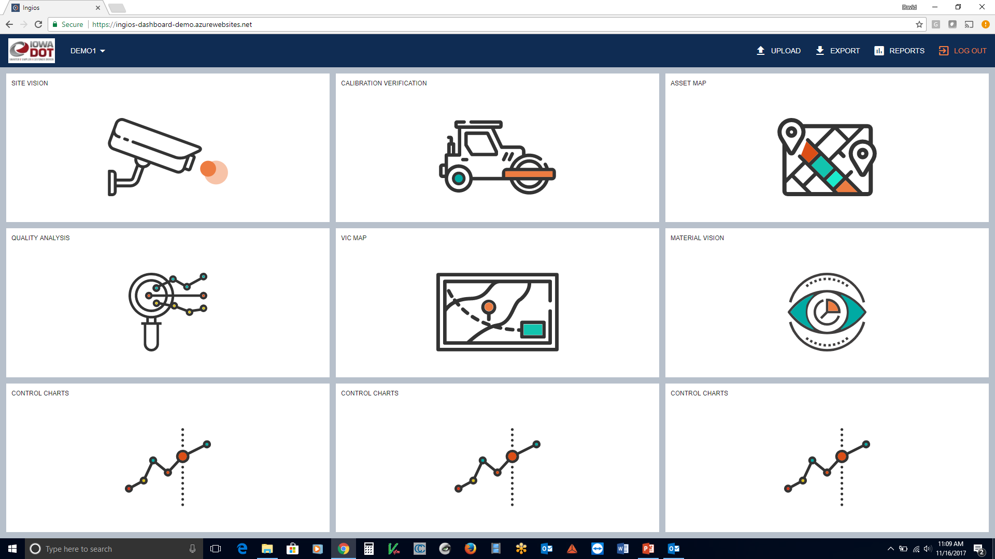
Ingios Customizable Dashboard System for Compaction Quality Assessment (Compaction Intelligence Dashboard)

Slide 9

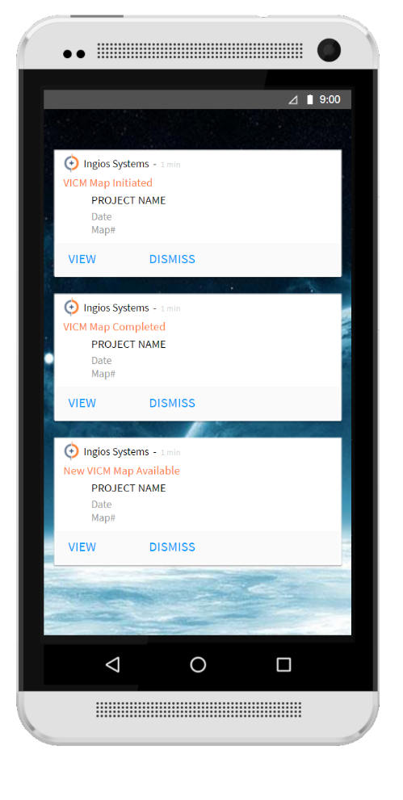
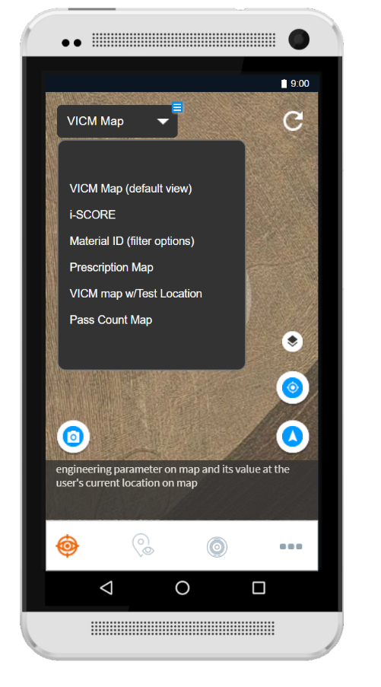
Ingios Dashboard – Mobile

Slide 10


Slide 11

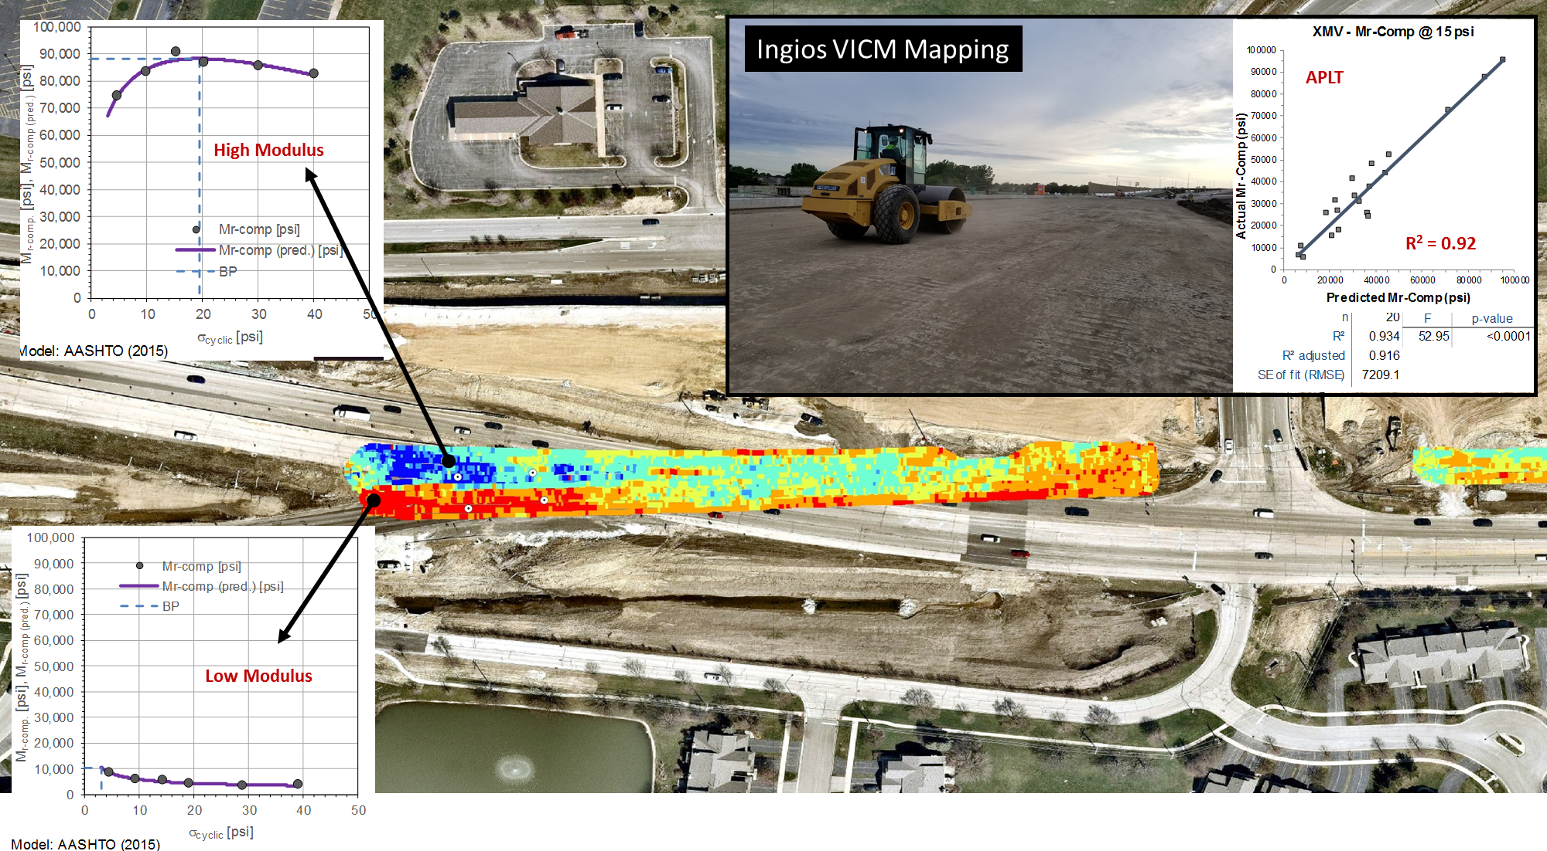
Ingios Modulus VIC System
Sensors

Slide 12
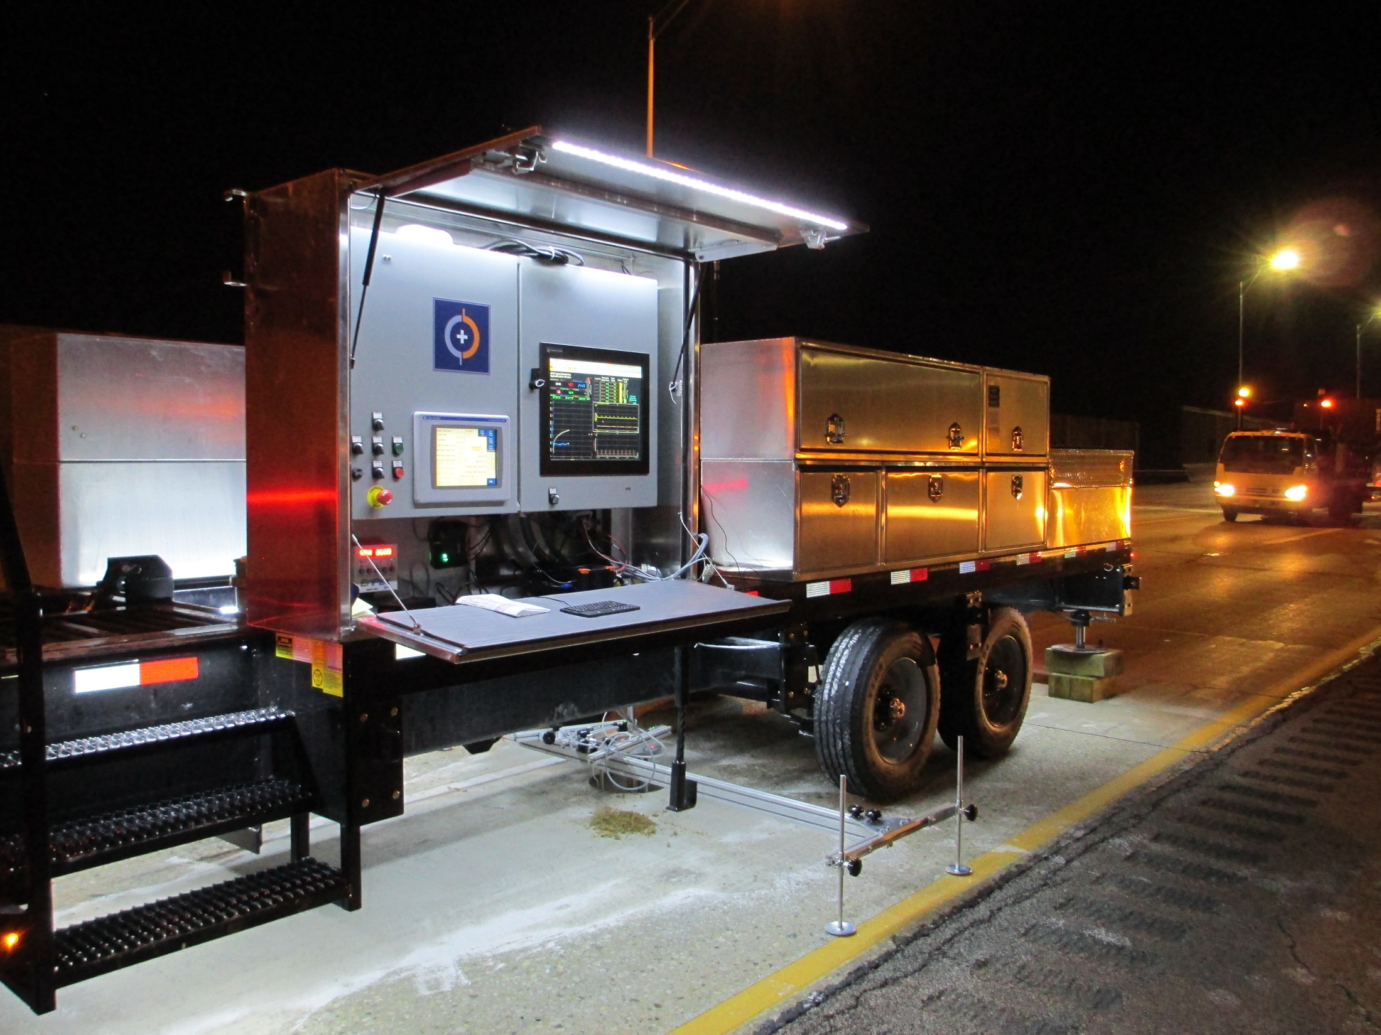


“ With the APLT technology, we now have actual measurements of how well the subgrade will support the pavement, so we can avoid overdesign.”
Steve Gillen, PE — IL Tollway Materials Manage
Automated Plate Load Testing Report:
I-294 NB and SB Lanes, MP. 17.5 to 40.0,
95th Street to Balmoral Ave
“The Tollway’s objective is to design and reconstruct this section of expressway in the most cost efficient manner for the life of the pavement.”

Slide 13
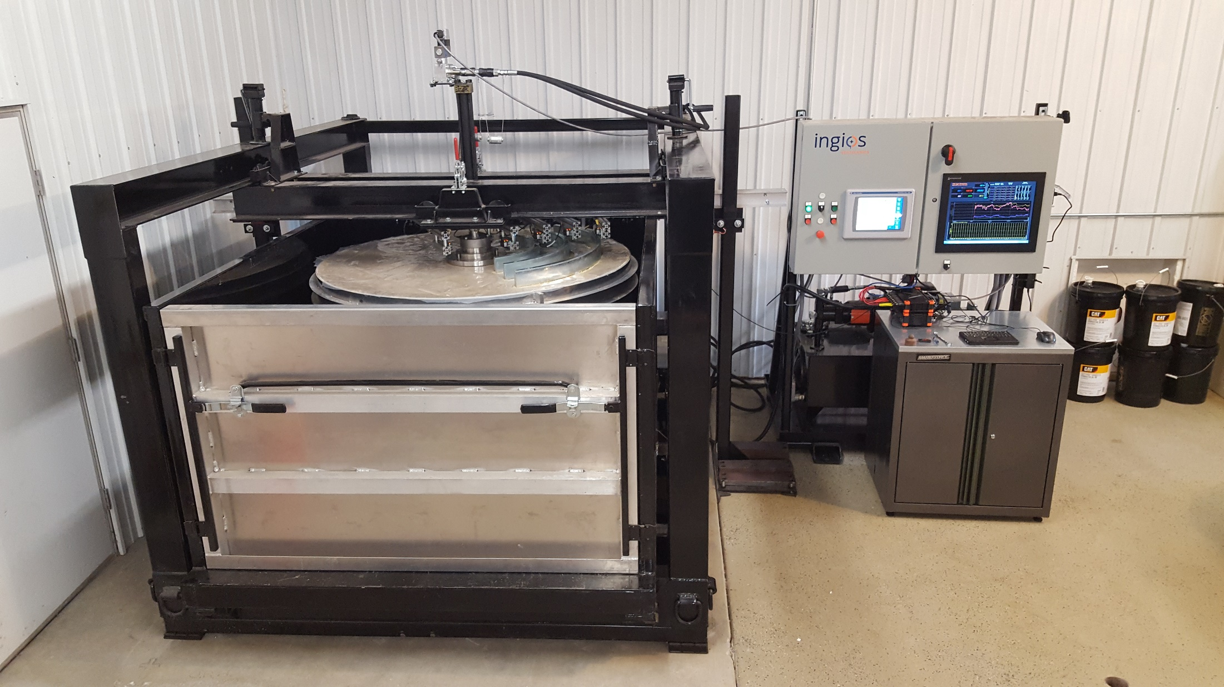
Ingios: Accelerated Testing System

Slide 14

Tenets of measurement …
Performance of pavements is directly coupled to the support provided by the pavement foundation layers and embankment.
Pavement foundation layer stiffness (resistance to deformation in response to an applied stress), permanent deformation (deformation not recovered from removal of applied stresses), and uniformity of support (localized variations) are critical factors affecting pavement performance, and therefore need to be measured to verify construction quality.
By measuring the critical engineering properties and understanding how they affect performance, pavement design methodologies can be improved. With improvements to design, pavement system performance can be optimized and risks of performance problems can be reduced.
Tenets of Pavement Foundation Measurement
PROJECT NAME: |  | 2017 MnROAD Unbound Layer Evaluation Using Intelligent Compaction
PROJECT ID: |  | MnROAD_IC
LOCATION: |  | MnROAD, Albertville, Wright County, MN

Slide 15
VIC Mapping Test Sections
Low Volume Road, MnRoad
SUMMARY
06/26/2017 to 09/01/2017
On Site Personnel
David J. White (Ingios)
Pavana Vennapusa (Ingios)
James Colby Van Nimwegen (Ingios)
PROJECT NAME: |  | 2017 MnROAD Unbound Layer Evaluation Using Intelligent Compaction
PROJECT ID: |  | MnROAD_IC
LOCATION: |  | MnROAD, Albertville, Wright County, MN

Slide 16
Cells 124-424
Cells 138-238
Cells 139-239
6 in. Class 5Q Aggregate Base
Existing Material
Mixture of existing subgrade and base material
6 in. Class 5Q Aggregate Base
Sand Subgrade
Cells 139-239
4 in. Common Borrow
Clay Loam Subgrade
Clay Loam Subgrade
Cells 185-186
Cells 188-189
Cells 133-235
12 in. Coarse (Cell 185) or Fine (Cell 186) Recycled Concrete Aggregate Base
12 in. Recycled Aggregate Base (Cell 189) or Crushed Limestone Base (Cell 188), Class 6
Cold Central Plant Rec. AC
Cells 133-235
Existing Base Material
Existing Base Material
3.5 in. Common Borrow
3.5 in. Common Borrow
Sand Subgrade
Clay Subgrade
Sections reworked
to include geosynthetic/geogrid at subbase/subgrade interface
Cells 128-228
Cells 127-227
6 in. Class 6 Aggregate Base
6 in. Class 6 Aggregate Base
Cells 128-228
Cells 127-227
9 in. Large Aggregate Subbase
9 in. Large Aggregate Subbase
18 in. Large Aggregate Subbase
18 in. Large Aggregate Subbase
Cell 227 – subbase placed in 2 lifts (9 in. each), Cell 127 – subbase placed in 1 lift
Cell 227 – subbase placed in 2 lifts (9 in. each), Cell 127 – subbase placed in 1 lift
Clay Subgrade
Clay Subgrade
Clay Subgrade
Clay Subgrade
SUMMARY OF DIFFERENT CROSS-SECTIONS W/ VIC MAPPING
PROJECT NAME: |  | 2017 MnROAD Unbound Layer Evaluation Using Intelligent Compaction
PROJECT ID: |  | MnROAD_IC
LOCATION: |  | MnROAD, Albertville, Wright County, MN

Slide 17
Summary of pavement foundation layer inputs for NRRA participating states.
STATE | PAVEMENT | DESIGN DESCRIPTION | SUBGRADE INPUTS | BASE/SUB-BASE INPUTS
CA | Flexible | HMA and base/subbase layer thickness based on R-value of the subgrade and Traffic Index | R-Value¹ | R-Value¹
 | Rigid | PCC and base/subbase layer thickness based on R-value of the subgrade and Traffic Index | R-Value¹ | M_{r} ²
IL | Flexible | Modified AASHTO Design procedure. Thickness design based on traffic factor and estimated structural number. | IBR value | Structural layer coefficients (a₂, a₃)
 | Rigid | Modified AASHTO Design procedure. Thickness design based on traffic factor and IBR or k-value. | IBR value or k-value³ | N/A [only minimum thickness]
MI | Flexible | Pavement ME Design [Similar to AASHTOWareTM] – Level 2 or 3 (Typical values) | M_{r}² | M_{r} ²
 | Rigid | Pavement ME Design [Similar to AASHTOWareTM] – Level 2 or 3 (Typical values) | M_{r} ² | M_{r} ²
MO | Flexible | AASHTO Pavement ME Design | M_{r} ⁶ | M_{r} ⁶
 | Rigid | AASHTO Pavement ME Design | M_{r} ⁶ | M_{r} ⁶
MN | Flexible | MnPAVE-Flexible with basic, intermediate, and advanced level. Advanced level requires moduli of all layers, while basic and intermediate levels require typical values or DCP test results, R-value results. | R-value⁴ (basic/int) or M_{r} (advanced) | DCP index⁴ (basic/int) or M_{r} (advanced)
 | Rigid⁵ | MnPAVE-rigid uses MEPDG level 3 based design procedure. | M_{r} | M_{r}
WI | Flexible | AASHTO 1972 design procedure. Thickness design based on design ESALs, soil support value, and estimated structural number. | Soil support value (correlated to CBR) | Structural layer coefficients (a₂, a₃)
 | Rigid | AASHTO 1972 design procedure. Thickness design based on design ESALs, working stress, and modulus of subgrade reaction (k) | k-value | NA
¹California R-value is a measure of resistance to deformation of the soils under saturated conditions and traffic loading as determined by the stabilometer test (CT301). Typical range between 5 (very soft) to 80 (treated base material). Typical values provided based on soil classification/ region.
²Typical resilient moduli vales are provided in the design guide based on the material type.
³Illinois bearing ratio (IBR) is a slight modification of CBR test run after 4-days of soaking. Typical values are provided based on soil classification (ranges between 2 and 20). Modulus of subgrade reaction (k) value vs. IBR is provided in the design nomographs.
⁴Minnesota R-value determined from modulus value (R = [0.41+0.873*(subgrade modulus/1000)]^1.28)
⁵MnPAVE-Rigid design procedure for PCC bonded overlay over HMA uses the ACPA procedure to determine composite k-value based on subgrade k-value and aggregate layer resilient modulus. http://apps.acpa.org/applibrary/KValue/
⁶personal communication, 03/02/2017, John P. Donahue, P.E., Construction and Materials Liaison Engineer, MoDOT
CalTrans Highway Design Manual - http://www.dot.ca.gov/hq/oppd/hdm/pdf/english/HDM_Complete_07Mar2014.pdf
ILDOT Pavement Design Manual - http://www.idot.illinois.gov/Assets/uploads/files/Doing-Business/Manuals-Split/Design-And-Environment/BDE-Manual/Chapter%2054%20Pavement%20Design.pdf
MDOT User Guide for ME Pavement Design: https://www.michigan.gov/documents/mdot/MDOT_Mechanistic_Empirical_Pavement_Design_User_Guide_483676_7.pdf
MnDOT Pavement Design Manual: www.dot.state.mn.us/materials/pvmtdesign/manual.html
WIDOT Facilities Development Manual: http://wisconsindot.gov/rdwy/fdm/fd-14-10.pdf

Slide 18
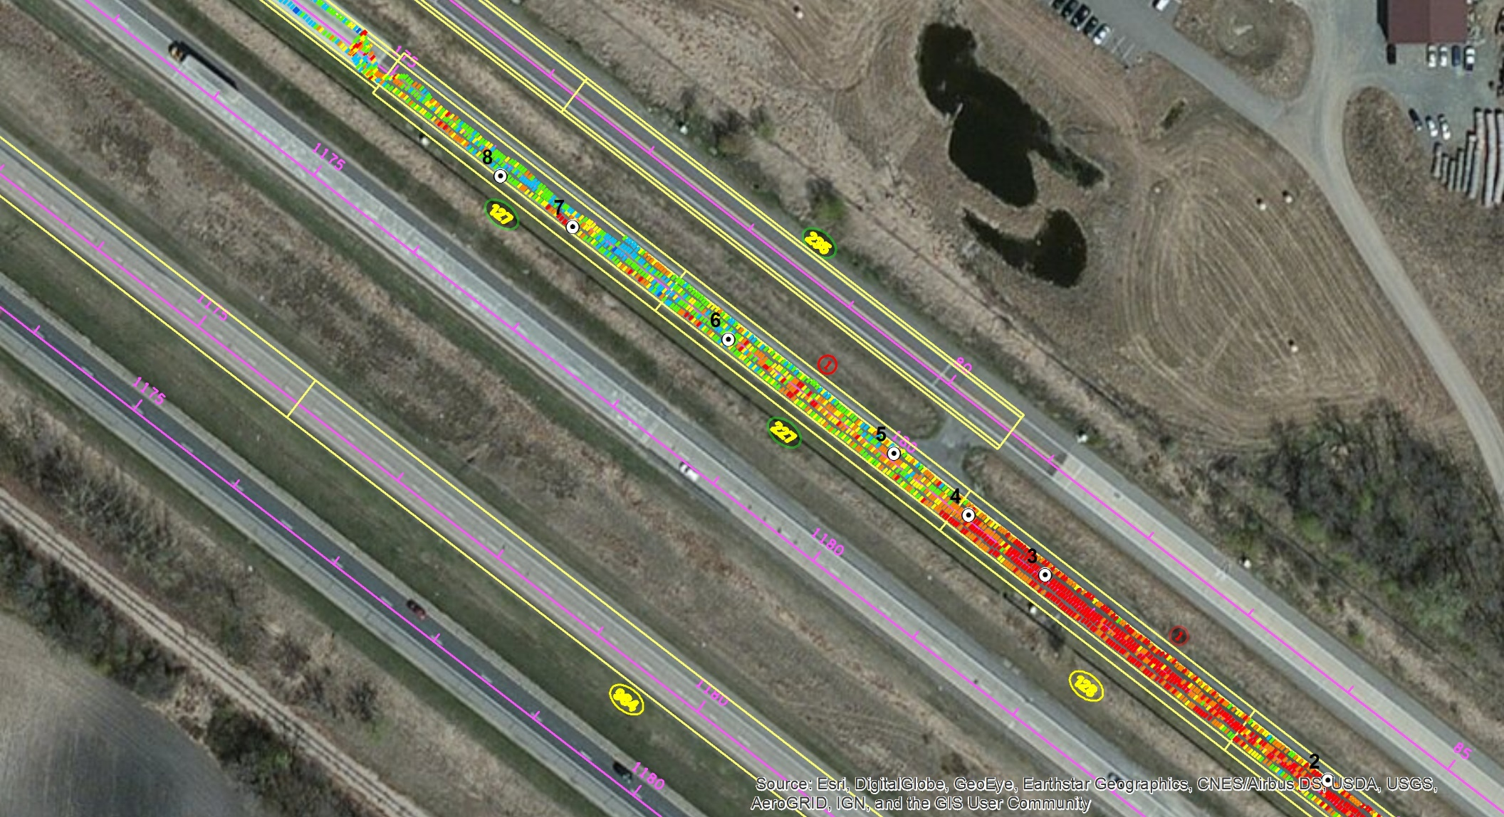
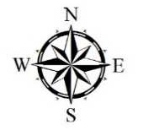
MAP ID: |  | Cells 127/227_Subbase
Surface Material: |  | Subbase
Mapping Time: |  | 5 min | 4 min
No. of Measurements: |  | 332 | 412
Meas. Property: |  | M_{r-SG} @ 10 psi plate contact stress
Mean: |  | 12.9 ksi | 11.7 ksi
Standard Deviation: |  | 3.1 ksi | 2.6 ksi
Coeff. Of Variation: |  | 24% | 22%
Machine: |  | CS56
Drum Configuration: |  | Smooth
Vibration Settings: |  | f = 30 Hz, low amp
Speed: |  | 3 mph (nominal)
8
7
VIC Calibration
Test Points
6
Cells 127-227
Cross-Section
5
VIC Calibration
Test Points
M_{r-SG}
< 8 ksi
18 in. Large Aggregate Subbase
10 ksi
12 ksi
15 ksi
20 ksi
Cell 227 – subbase placed in 2 lifts (9 in. each), Cell 127 – subbase placed in 1 lift
30 ksi
40 ksi
>40 ksi
Clay Subgrade
0
125
250
375
500
Feet
DATE: |  | 08/17/2017
OPERATOR: |  | PV (Ingios)
Ingios VIC Record – VIC_M_{r-SG} @ 10 psi Plate Contact Stress
PROJECT NAME: |  | 2017 MnROAD Unbound Layer Evaluation Using Intelligent Compaction
PROJECT ID: |  | MnROAD_IC
LOCATION: |  | MnROAD, Albertville, Wright County, MN

Slide 19
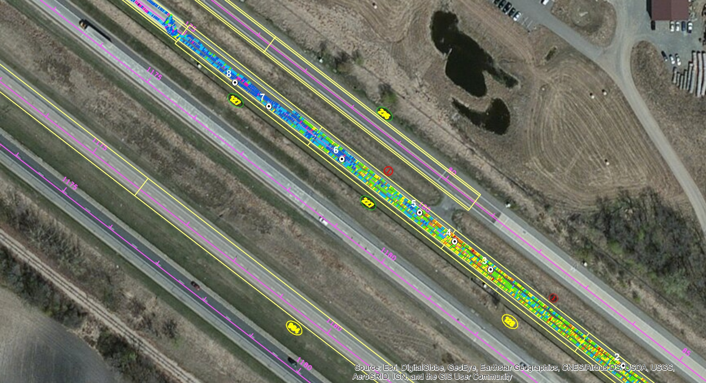
MAP ID: |  | Cells 127/227_Subbase
Surface Material: |  | Subbase
Mapping Time: |  | 5 min | 4 min
No. of Measurements: |  | 332 | 412
Meas. Property: |  | M_{r-Base} @ 10 psi plate contact stress
Mean: |  | 21.3 ksi | 15.4 ksi
Standard Deviation: |  | 4.8 ksi | 4.1 ksi
Coeff. Of Variation: |  | 23% | 26%
Machine: |  | CS56
Drum Configuration: |  | Smooth
Vibration Settings: |  | f = 30 Hz, low amp
Speed: |  | 3 mph (nominal)
8
7
VIC Calibration
Test Points
6
Cells 127-227
Cross-Section
5
VIC Calibration
Test Points
M_{r-Base}
< 8 ksi
18 in. Large Aggregate Subbase
10 ksi
12 ksi
15 ksi
20 ksi
Cell 227 – subbase placed in 2 lifts (9 in. each), Cell 127 – subbase placed in 1 lift
30 ksi
40 ksi
>40 ksi
Clay Subgrade
0
125
250
375
500
Feet
DATE: |  | 08/17/2017
OPERATOR: |  | PV (Ingios)
Ingios VIC Record – VIC_M_{r-Base} @ 10 psi Plate Contact Stress
PROJECT NAME: |  | 2017 MnROAD Unbound Layer Evaluation Using Intelligent Compaction
PROJECT ID: |  | MnROAD_IC
LOCATION: |  | MnROAD, Albertville, Wright County, MN

Slide 20
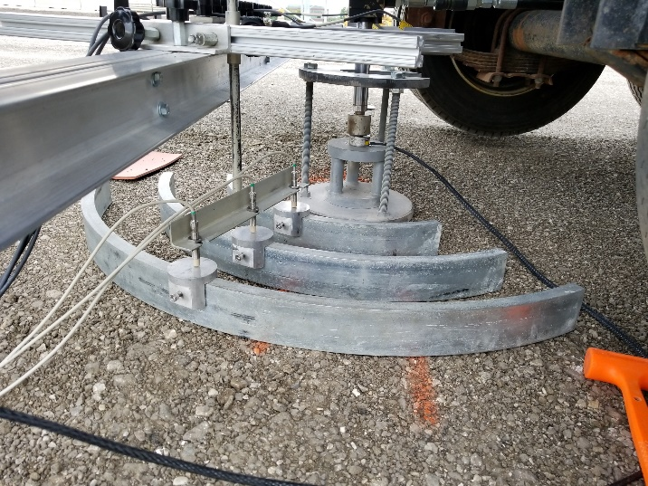
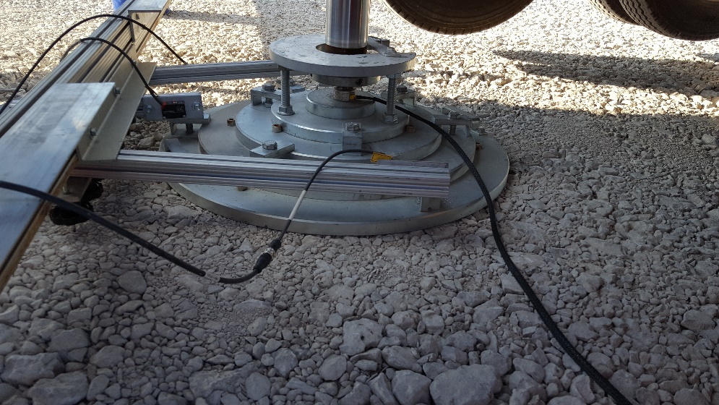
NOTE: Ingios VICM calibration record provided below are results from recent off-site calibration (June 21-22, 2017) performed on the CS56 smooth drum vibratory roller used at MnROAD. The calibration plots summarize the calibration validity range for the three measurement parameters presented, coefficient of determination (R²) value, and the standard error (RE) values of the measured versus predicted values. Site and material specific calibration is planned for August 14-18 cell construction.
Composite Resilient Modulus at 10 psi cyclic stress
Modulus of Subgrade Reaction at 10 psi (initial load)
Modulus of Subgrade Reaction at 10 psi (reload)
Mr-Comp @ 10 psi cyclic stress
using 12 in. diameter loading plate
k1 and k2 values for 30 in. diameter static plate load test
Ingios VICM Calibration Record
PROJECT NAME: |  | 2017 MnROAD Unbound Layer Evaluation Using Intelligent Compaction
PROJECT ID: |  | MnROAD_IC
LOCATION: |  | MnROAD, Albertville, Wright County, MN

Slide 21
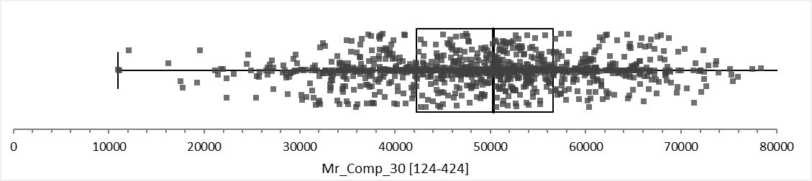
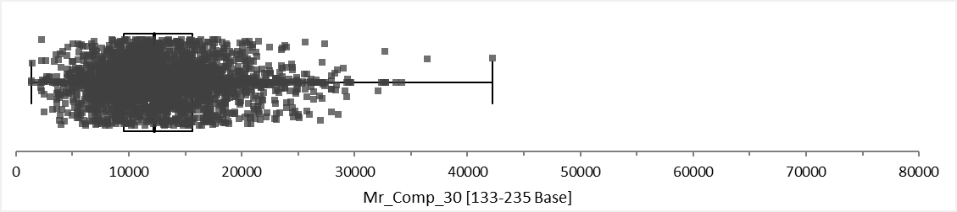
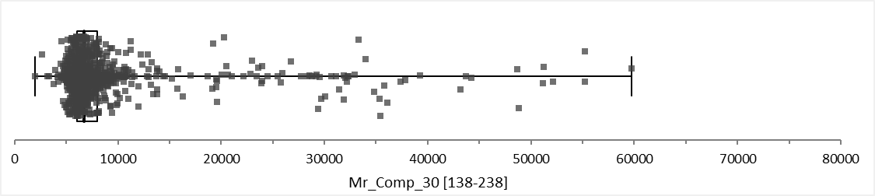
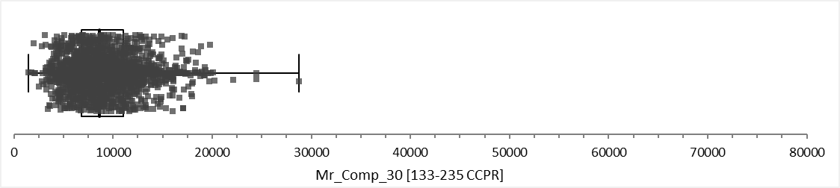
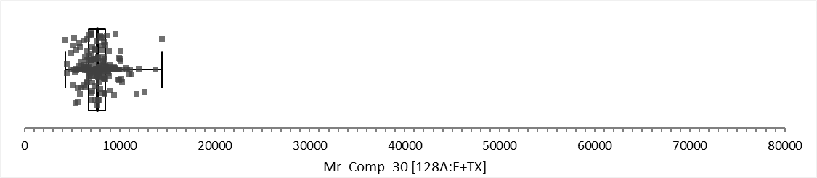
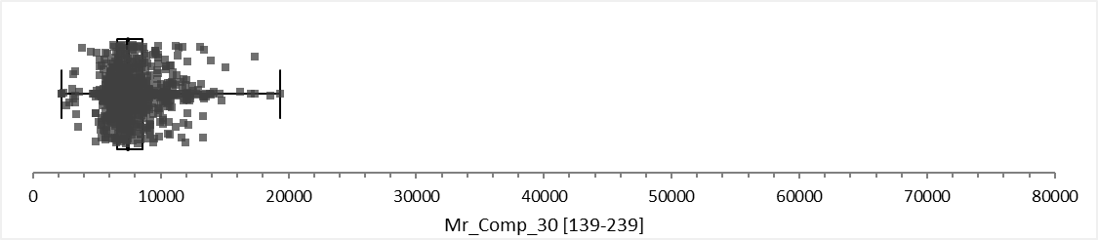
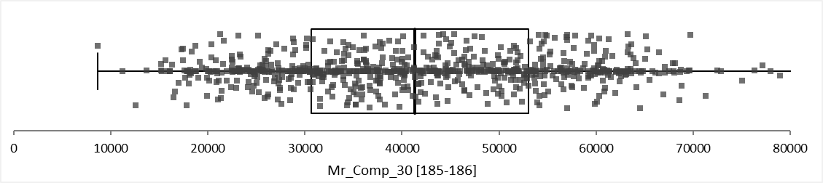
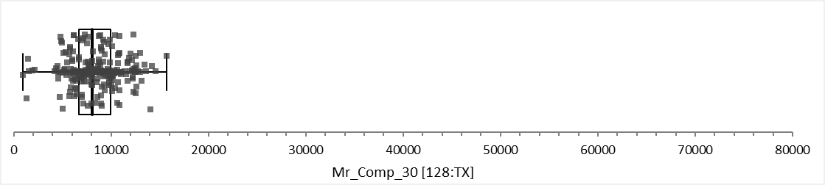
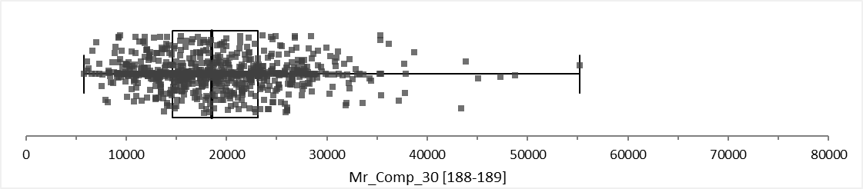

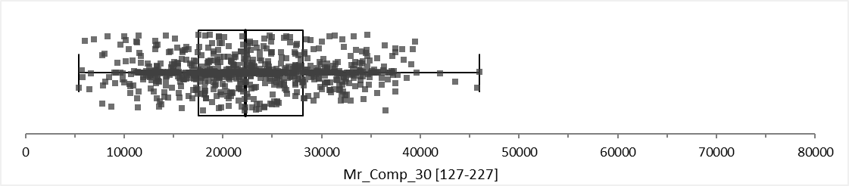
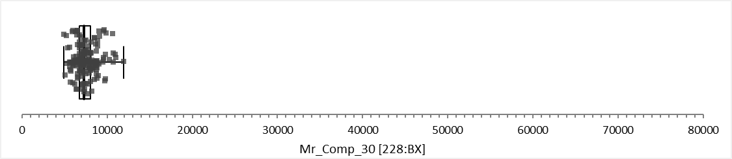
Box Plots – M_{r-Comp}_30 psi
[124-424]
[133-235 Base]
[138-238]
[133-235 CCRP]
[139-239]
[128:F+TX]
[185-186]
[128:TX]
[188-189]
[228:F+BX]
[127-227]
[228:BX]
Box and Jitter plots of M_{r-Comp} @ 30 psi plate contact stress
PROJECT NAME: |  | 2017 MnROAD Unbound Layer Evaluation Using Intelligent Compaction
PROJECT ID: |  | MnROAD_IC
LOCATION: |  | MnROAD, Albertville, Wright County, MN

Slide 22
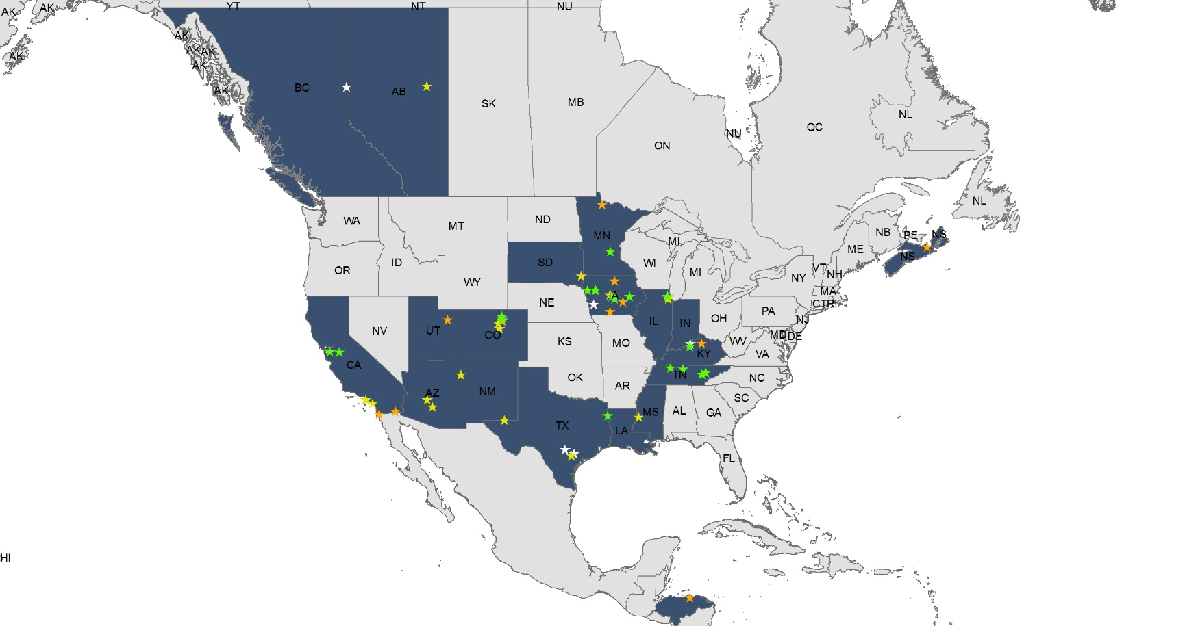

Thank you.
Contact Info:
www.ingios.com
1-877-325-6278
Office Locations:
Northfield, MN (David J. White, Ph.D., P.E.)
Little Elm, TX (Pavana Vennapusa, Ph.D., P.E.)
Ames, IA (E. Thomas Cackler, P.E.)
Boston, MA (Brendan FitzPatrick, P.E.)

